Slide 1
CHATBOT A PPT BY Vipasha Ratwani RA2111056010030 Charugundla NV Krishna Parvani RA2111056010017 Prathosh M. Vishweshwar RA2111056010016

Slide 2

CHATBOT FOR ORDERING FOOD:
DESCRIPTION OF THE PROJECT:
At the most basic level, a chatbot is a computer program that simulates and processes human conversation (either written or spoken), allowing humans to interact with digital devices as if they were communicating with a real person. User communicate with chatbot via the chat interface or by voice, like how they talk to real person. Chatbots interpret and process user's words or phrases and give an instant pre-set answer.
. Food ordering chat bot
. Ordering through text
. Can be converted to voice
. Configuration text is through files

Slide 3
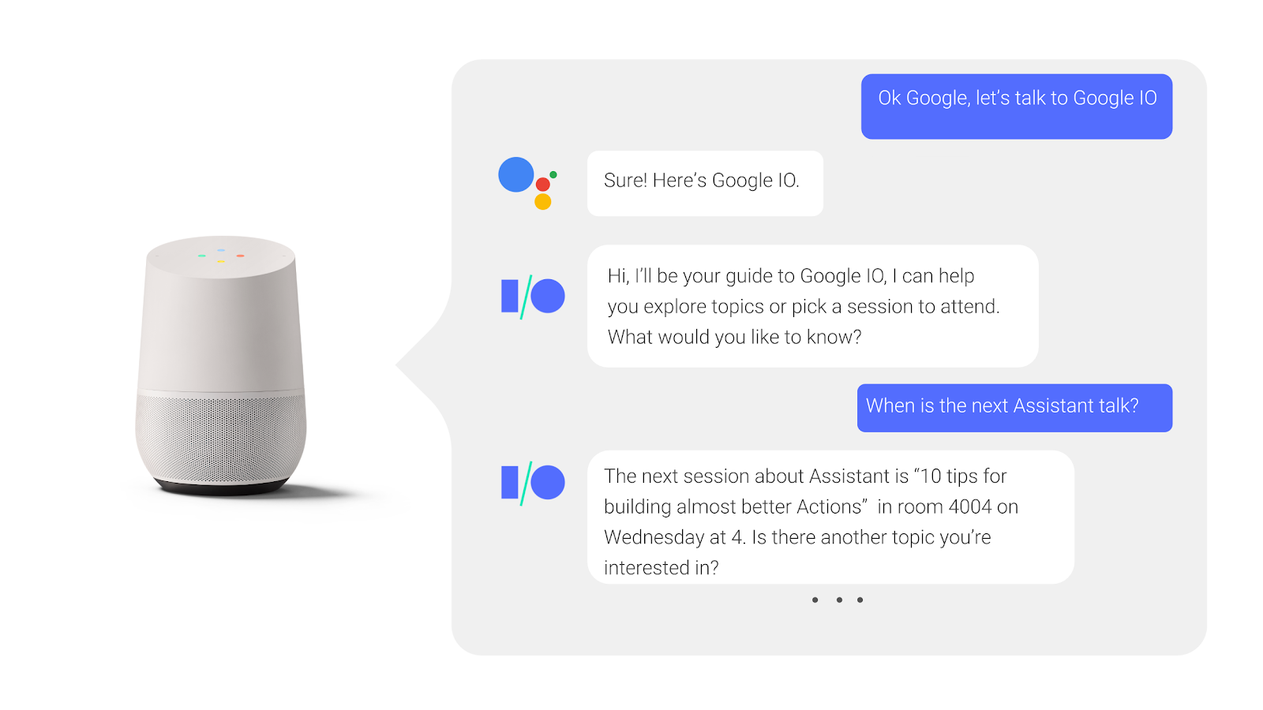
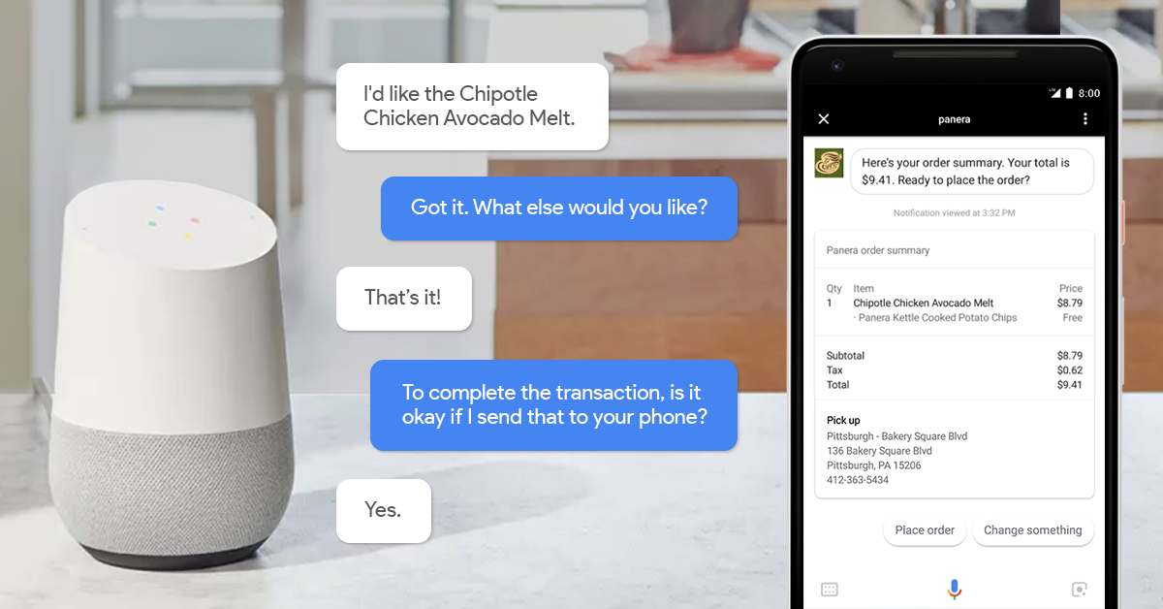
HERE ARE SOME EXAMPLES:

Slide 4
ALGORITHM:
STEP 1: Start
STEP 2: Declare the following functions:
. type
. category
. submenu
. option
. total
. soption
STEP 3: Declare the following variables
. username
. welcome
. category
. meals
. juice

Slide 5
. deserts
. mobile
. support
STEP 4: Display "CHATBOT FOR ORDERING FOOD"
STEP 5: If(decision=0)
. Display "bye" to exit
STEP 6: If(decision=1)
. Display "hello" to start
STEP 7: If(decision=2) and if 1 is chosen
.Display" welcome"
1.order
STEP 8: If(decision=3) and the chosen number is 1
.Display "category"
STEP 9: If(decision=4) and the category 1 is chosen
STEP 10: If(decision=5) and the submenu 2 is chosen
STEP 11: If(decision=6) and the submenu 3 is chosen

Slide 6
STEP 12: Display "confirm order”
STEP 13: If "yes" is chosen
. Display "Your order total"
STEP 14: If "no" is chosen
. Display "Add more items"
If (decision =3) order is decided take category and go to step 7 and repeat the process.
STEP 15: If "cancel" is chosen, it restarts from step 5.
STEP 16: If "bye" is chosen, the process exit.
STEP 17: If "2" is chosen (from STEP 7)
. Display "support"
STEP 18: In support if "1" is chosen
. Display "Please Contact support:999-999-999 Thank you"
STEP 19: If "2" is chosen
. Display "Please Contact:100-110-111 Thank you"
STEP 20: End

Slide 7
PSEUDOCODE:
1.Start
2.Show initial screen
3.Show welcome message
4.ask user to enter order or support
5.if order choose category or submenu
6.if category meals choose sub category
7.if category juice choose sub category
8.if category deserts choose sub category
9.if support display option 1 is order support 2 is refund/cancel
10.options to user to add more, exit or cancel order
11.if confirm order is yes show total and exit
12.if bye exist
13.if order more go to category
14.if cancel order – go to welcome message and start over
15.end

Slide 8
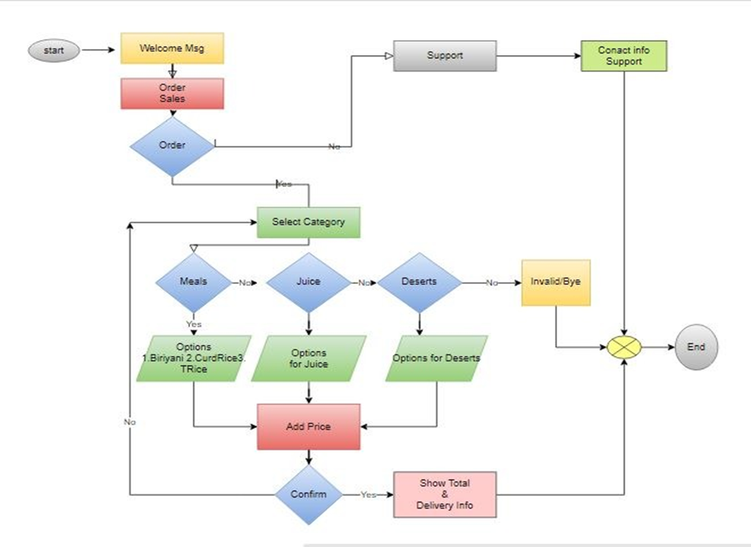
FLOWCHART

Slide 9
CODE
#include <stdio.h>
#include <string.h>
int type,catg,submenu,option;
int total=0;
char soption[50];
/*********************
decoding the option to text/string form
input : option in int form
output : string name in global array soption[]
*******************/
void decode(int option)
{
if (option==1) {
strcpy(soption,": Veg Biriyani Rs 150/-");
total = total + 150;

Slide 10
}
if (option==2) {
strcpy(soption,": Tomato Rice Rs 90/- ");
total = total + 90;
}
if (option==3) {
strcpy(soption,": Curd Rice Rs 50/-");
total =total +50;
}
if (option==4) {
strcpy(soption,": Fruitninja Rs 20/-");
total += 20;
}
if (option==5) {
strcpy(soption,": Tornado Rs 25/-");
total += 25;
}

Slide 11
if (option==6) {
total+=30;
strcpy(soption,": Lightning Bolt Rs 30/- ");
}
if (option==7) {
total += 100;
strcpy(soption,": Cake Rs 100/-");
}
if (option==8) {
total += 40;
strcpy(soption,": Ice Cream Rs 40/-");
}
}
/*******************
To add line based on supplied character as argument
input : function argument as character
output : 80 characters in one row

Slide 12
*******************/
void beautyline(char *c){
printf("\n");
for (int i=0;i< 80; i++) {
printf("%c",*c);
}
printf("\n");
}
/*********************
file : srmeats2.c
input : config.txt
*********************/
int main() {
char useranswer[100] ="default" ;
char welcome[100] ;
char category[100] ;
char meals[100]

Slide 13
char juice[200];
char deserts[100];
char support[100];
char mobile[20];
char filename[20] = "config.txt";
FILE *fp; int i;
char line [200];
fp = fopen(filename, "r");
if (fp == NULL)
{
printf("Error: could not open file %s", filename);
return 1;
}
if (fgets(line,sizeof (line),fp)!= NULL){
strcpy(welcome,line) ;
// printf("%s\n", welcome);
}

Slide 14
if (fgets(line,sizeof (line),fp)!= NULL){
strcpy(category, line) ;
// printf("%s\n", category);
}
if (fgets(line,sizeof (line),fp)!= NULL){
strcpy(meals,line) ;
// printf("%s\n", meals);
}
if (fgets(line,sizeof (line),fp)!= NULL){
strcpy(juice,line) ;
// printf("%s\n", juice);
}
if (fgets(line,sizeof (line),fp)!= NULL){
strcpy(deserts,line) ;
// printf("%s\n", deserts);
}
if (fgets(line,sizeof (line),fp)!= NULL){

Slide 15
strcpy(support,line) ;
// printf("%s\n", deserts);
}
fclose(fp);
// readfromfile();
int decision=0;
while (strcmp(useranswer, "bye") !=0) {
if (decision ==0 ) { //get hello string
beautyline("*");
printf(" CHATBOT FOR ORDERING FOOD\n");
scanf("%s", useranswer);
}
if (decision==0 && (strcmp(useranswer, "hello") ==0)){
decision=1;
}
// printf("%s\n",response2);

Slide 16
if (decision ==1){ //welcome
printf("%s\n", welcome);
decision =2; //order or support
scanf("%s", useranswer);
printf("you chosen : %s\n", useranswer);
if (strcmp(useranswer, "1") ==0)
decision =3; //order
} if (decision==3 || strcmp(useranswer, "1") ==0){ //order
//printf("you chosen : %s\n", useranswer);
//type=1;
decision=3; //category
if (decision==3) {
printf("%s\n",category);
scanf("%s", useranswer);
}
if (strcmp(useranswer, "1") ==0){// category meals

Slide 17
printf("you chosen : %s\n", useranswer);
decision=4
if (decision==4) {
printf("%s\n", meals);
scanf("%d", &submenu);
if (submenu <1 || submenu > 3 ) {
printf ("invalid\n"); decision=4; continue;
}
option = submenu;
}
}//meals
else if (strcmp(useranswer, "2") ==0){ //juice
printf("you chosen : %s\n", useranswer);
//catg=2;
decision=5;
if (decision ==5 ) {
printf("%s\n", juice);

Slide 18
scanf("%d", &submenu);
printf("you chosen : %d\n", submenu);
}
if (submenu <1 || submenu > 3 ) {
printf ("invalid\n");
decision=5;
continue;
}
option = submenu+3;
} //juice
else if (strcmp(useranswer, "3") ==0){ //desert
printf("you chosen : %s\n", useranswer);
//catg=3;
decision=6;
if (decision==6) {
printf("%s\n", deserts);
scanf("%d", &submenu);

Slide 19
}
if (submenu <1 || submenu > 2 ) {
printf ("invalid\n"); decision=6; continue;
}
option = submenu+6;
} //deserts
decode(option);
printf("Confirm Order %s . \nPlease type \n yes to confirm order and exit. \n no to add more items. \n cancel to cancel and restart. \n bye to exit.\n ",soption);
scanf("%s",useranswer);
if (strcmp(useranswer, "yes") ==0) {
beautyline("*");
printf("Your order total : %d \n ",total);
printf("\nplease enter mobile number\n");
scanf("%s",mobile);
printf("\nConfirmed order will be delivered soon!\n Thank you!\n");

Slide 20
beautyline("*");
scanf("%s",mobile);
return 1;
}
else if (strcmp(useranswer, "no") ==0) {
printf(" Add more items-\n");
decision =3; //order is decided take category
// strcpy(useranswer, "1");
continue;
}
else if (strcmp(useranswer, "cancel")==0){
decision =0; continue;
}
else if (strcmp(useranswer, "bye") ==0) {
return 1;
}
}//order

Slide 21
else if (strcmp(useranswer, "2") ==0) { //support
printf(" %s\n", support);
scanf("%s", useranswer);
//type=2;
if (strcmp(useranswer, "1") ==0)
printf("Please Contact support: 999-999-999\nThank you");
if (strcmp(useranswer, "2") ==0)
printf ("please contact: 100-110-111\nThank you");
return 1;
}
}
return 1;
}

Slide 22
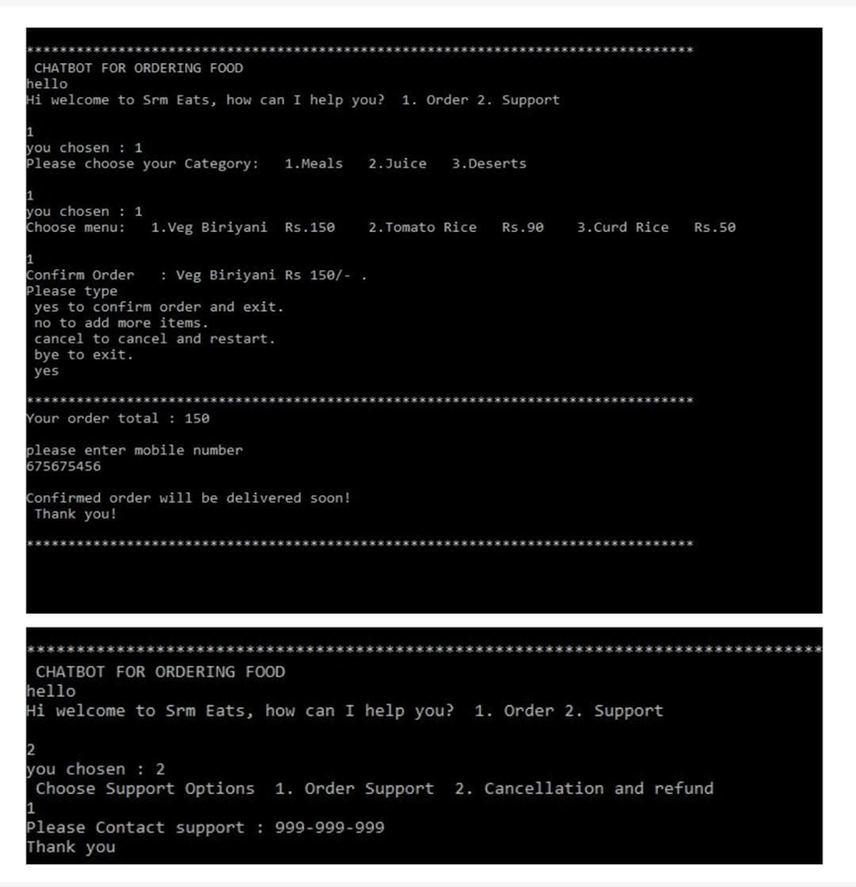
OUTPUT
THANK YOU

